Slide 1
RNA velocity analysis of the BM-32 samples
Zinger Yang Loureiro
October 12, 2021

Slide 2
Trajectory analysis of scRNA-seq results may provide further insight into the cell movement, development
Red marrow progenitor
do progenitors travel?
Yellow marrow progenitor
Notes:
To assess the heterogeneity of the undifferentiated HACAPs, we focus on just the results of the undifferentiated samples. permanent aspects in a cell’s identity as its type and the more transient elements as its state

Slide 3
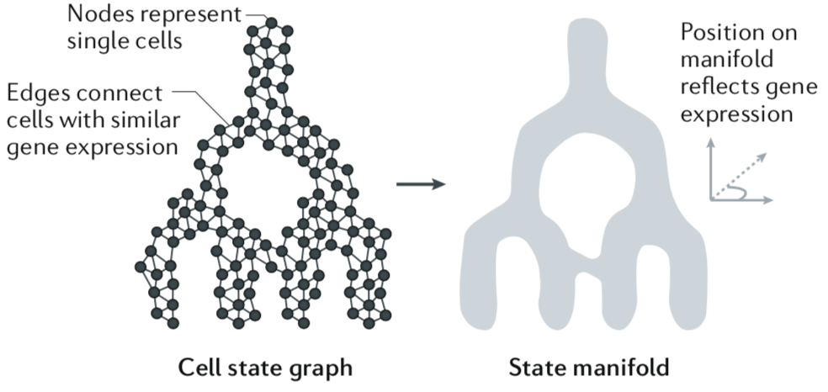
Trajectory inferences
Trajectory inference methods interpret single-cell data as a snapshot of a continuous process. This process is reconstructed by finding paths through cellular space that minimize transcriptional changes between neighbouring cells
“Two-dimensional representations… can be misleading, as they distort high-dimensional structures upon ‘flattening’ them, and in some cases algorithms force tree-like visual layouts that may further distort the original structure…. The dynamics predicted from cell state snapshots should thus be considered hypotheses”
Wagner, D.E. & Klein,A.M., Nat Rev Genetics, (2020)

Slide 4
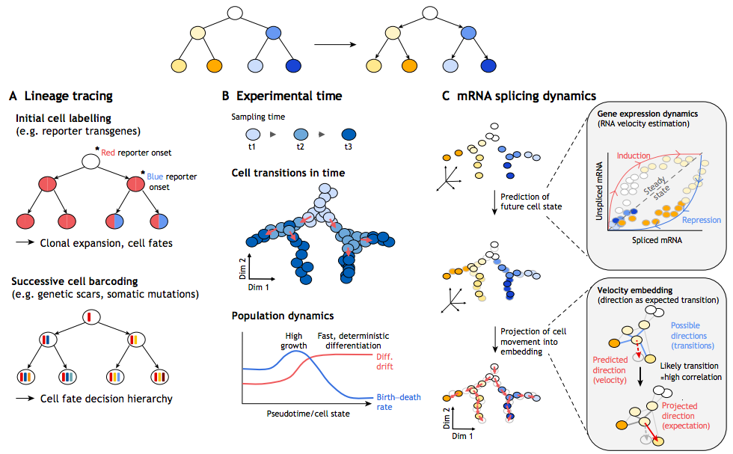
Approaches for inferring directionality and dynamics in trajectories
Tritschler, S., et al. Development (2019).

Slide 5
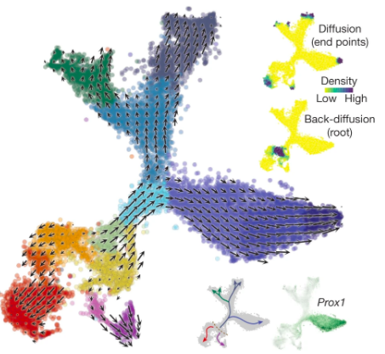
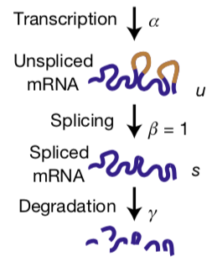
RNA velocity exploits underlying molecular kinetics to predict gene expression changes in cells
mRNA abundance over time (dS/dt) is the velocity of gene expression
The relative abundance of nascent (unspliced) and mature (spliced) mRNA can be exploited to estimate the rates of gene splicing and degradation
RNA velocity field projected onto the t-SNE plot. Arrows show the local average velocity evaluated on a regular grid.
La Manno, G. et al. Nature (2018).
Notes:
Top right inset, differentiation endpoints as high density regions on the manifold after forward Markov process with velocity-based transition probabilities; the root of the branching tree is identified simulating the process in the reverse direction. Bottom right inset, summary schematic of the RNA velocity field, and expression of the transcription factor Prox1.
spliced and unspliced RNA abundances are jointly modeled in order to infer a ‘direction of change’ and thereby a future state for each cell in the gene expression space.

Slide 6
The balance of un-spliced and spliced mRNA abundance is an indicator of the future state of mature mRNA abundance, and thus the future state of the cell.
Induction: toward an increase in expression
Model of transcription dynamic
un-spliced
Steady state (equilibrium of
un-spliced vs spliced)
un-spliced
spliced
spliced
Repression: toward a decrease in expression
un-spliced
spliced

Slide 7
The similarity of the extrapolated cell states to cells in local neighborhood could be visualized as local averaged vector fields
This neighbor cell matches orange cell’s predicted future state.

Slide 8
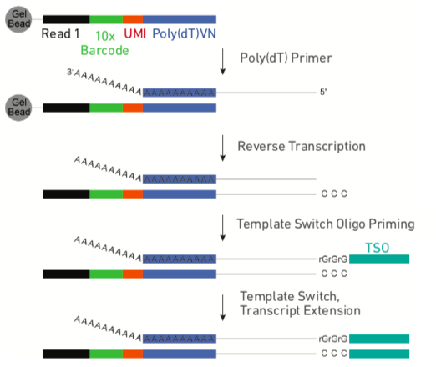
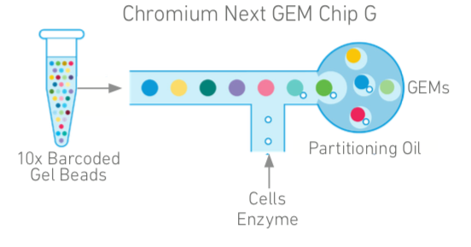
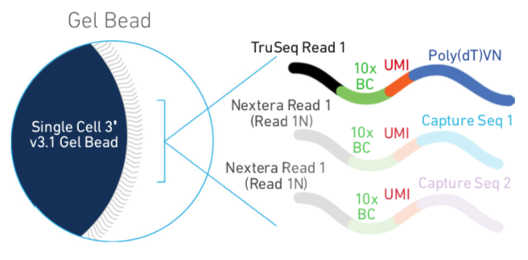
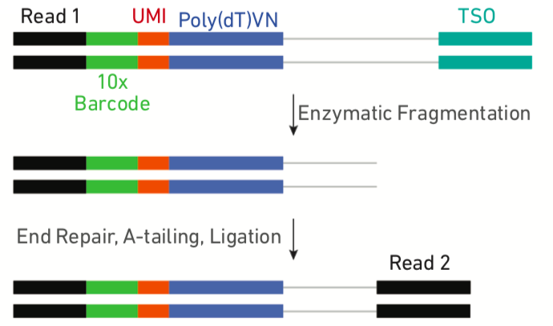
10X genomic workflow sequences only the mRNA 3’ ends. Thus, only limited splicing information is used in the velocity analysis.
cDNA amplification
Notes:
We look for traces that range between 400 – 1000bp with a significant amount of inserts that are 400 – 600bp in length. Inserts in this size range are optimal for cluster formation in Illumina® flowcells.

Slide 9
Analysis of the BM-32 samples
Re-alignment of sequencing results to capture both spliced and un-spliced information (HPCC)
Velocity analysis and visualization (R)
BMY
BMR
BMS
BMY+BMR
* Analysis included only cells defined in Iteration 3, min.feature=2000 analysis.
** BMY + BMR analysis was reaching the limit of my laptop workstation.

Slide 10
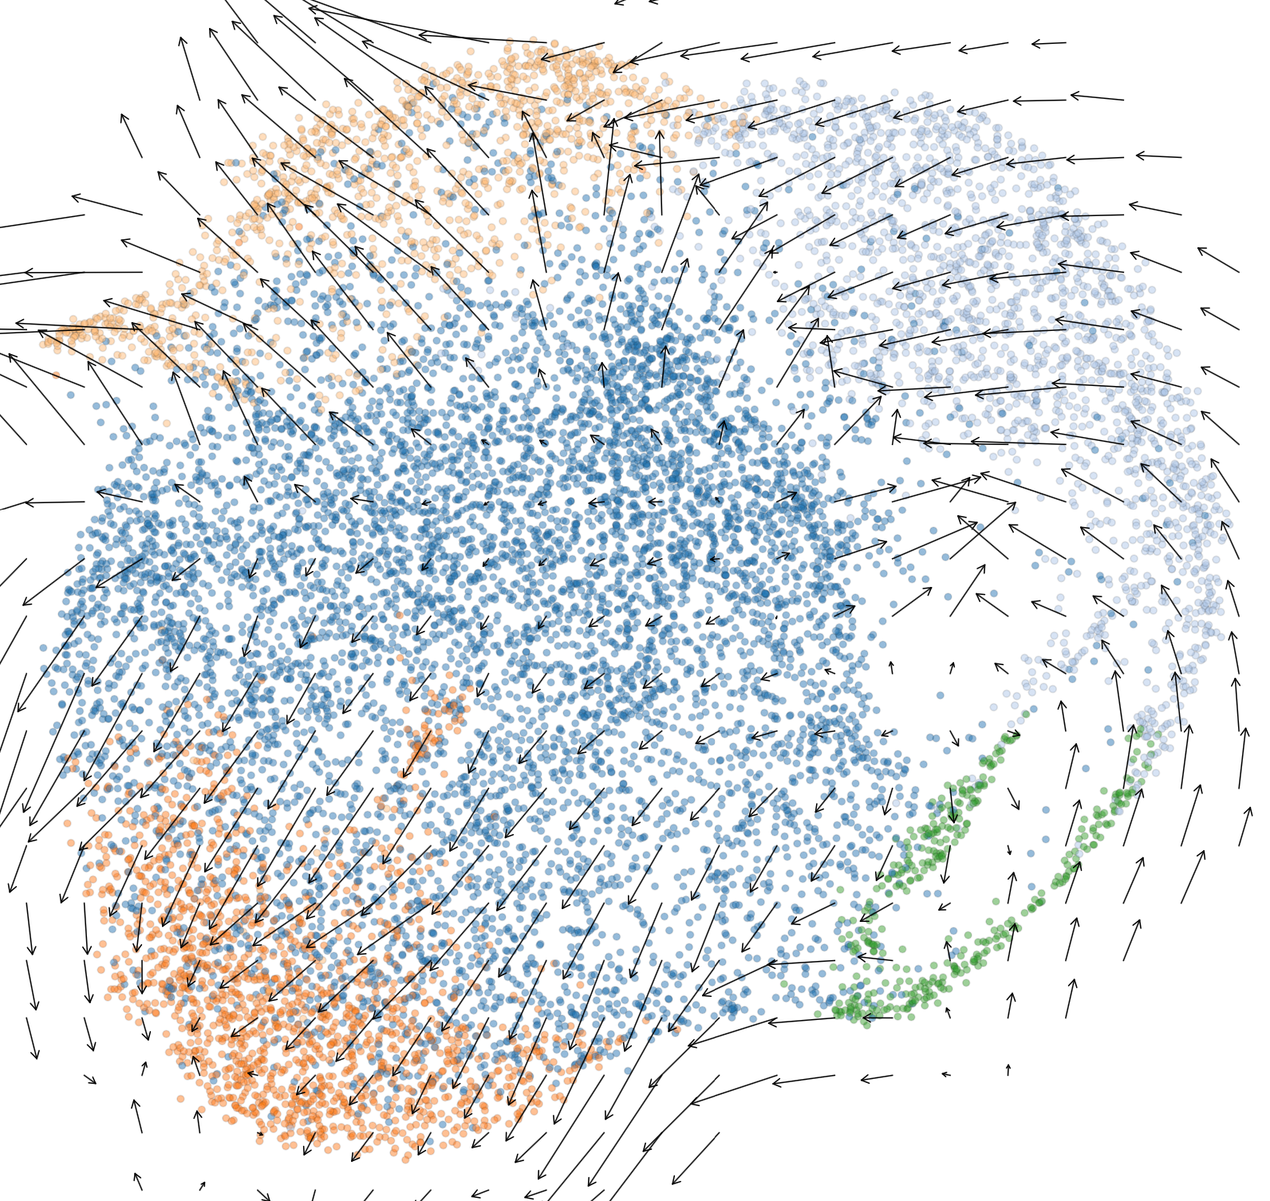
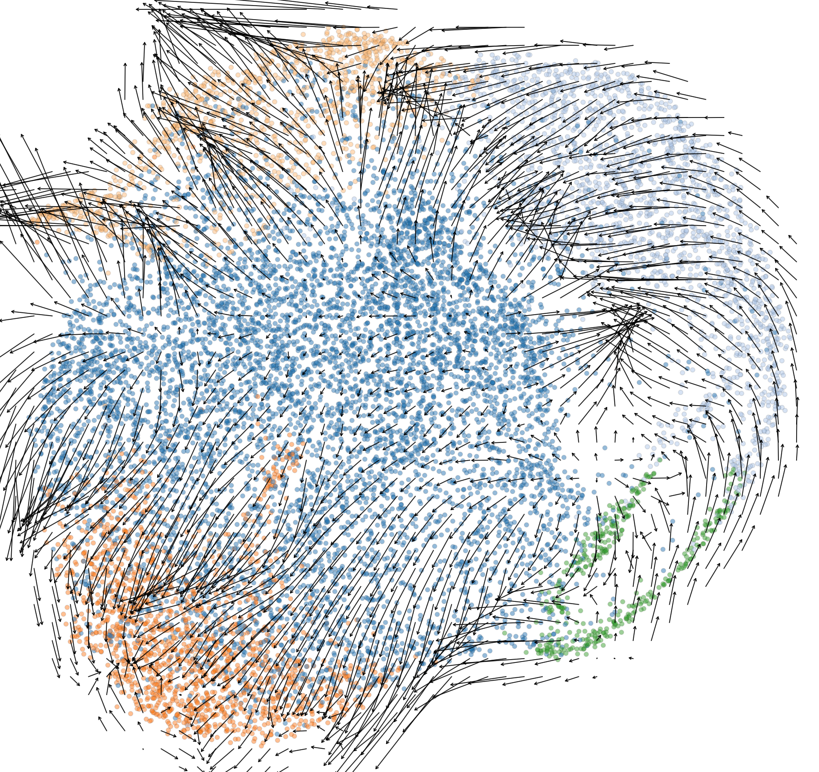
BMR-32
grid.n: number of grid points along each axis
grid.n = 25
grid.n = 50
UMAP_2
UMAP_1
Figure PDF with higher resolution rendering is available in the Dropbox Iteration 4 folder

Slide 11
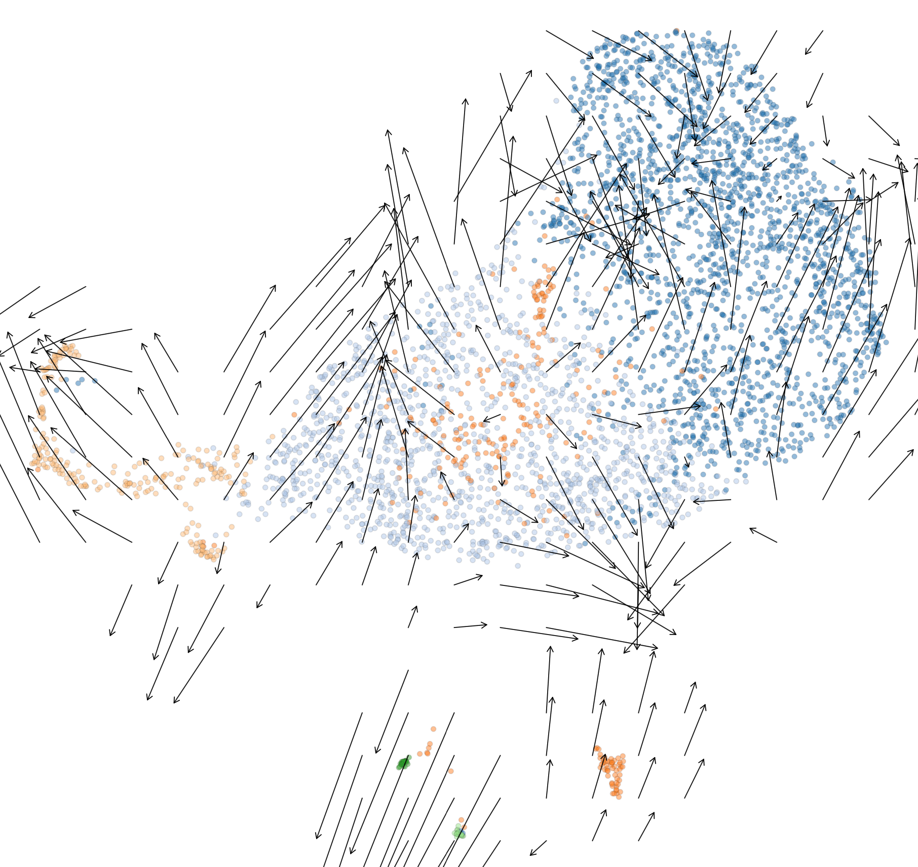
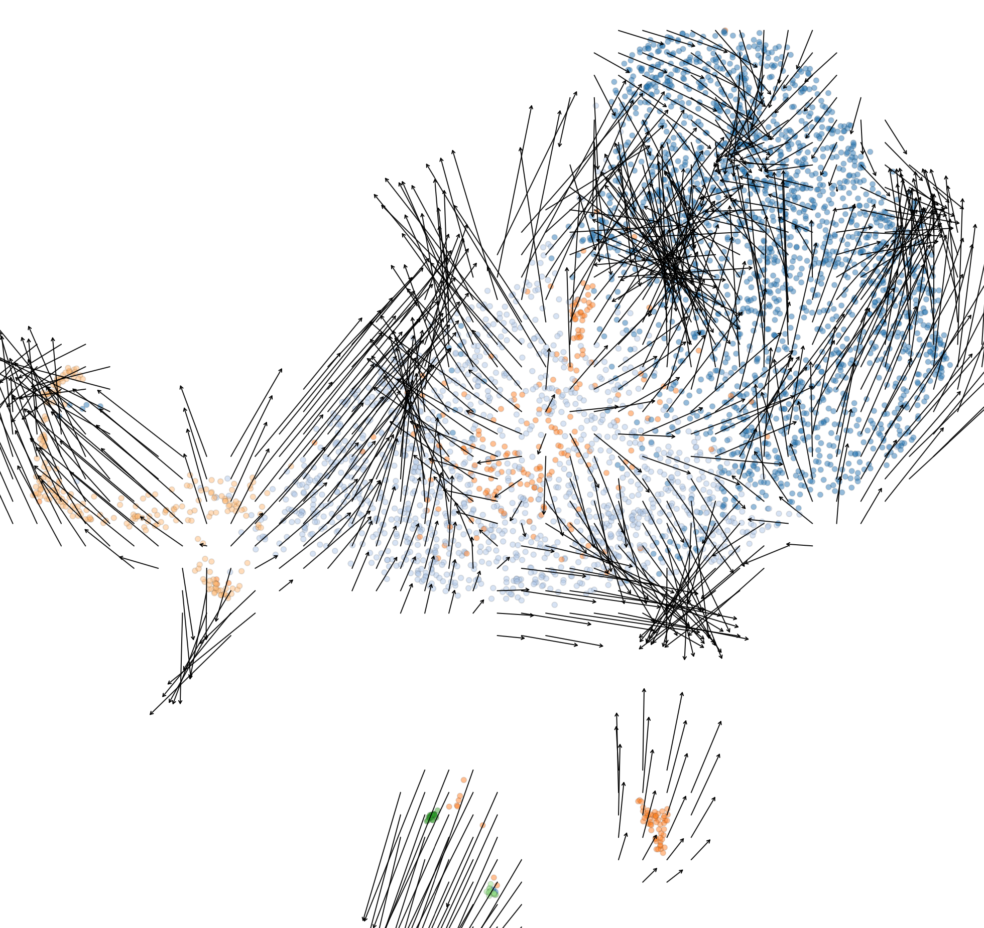
BMY-32
grid.n: number of grid points along each axis
grid.n = 25
grid.n = 50
UMAP_2
UMAP_1
Figure PDF with higher resolution rendering is available in the Dropbox Iteration 4 folder

Slide 12
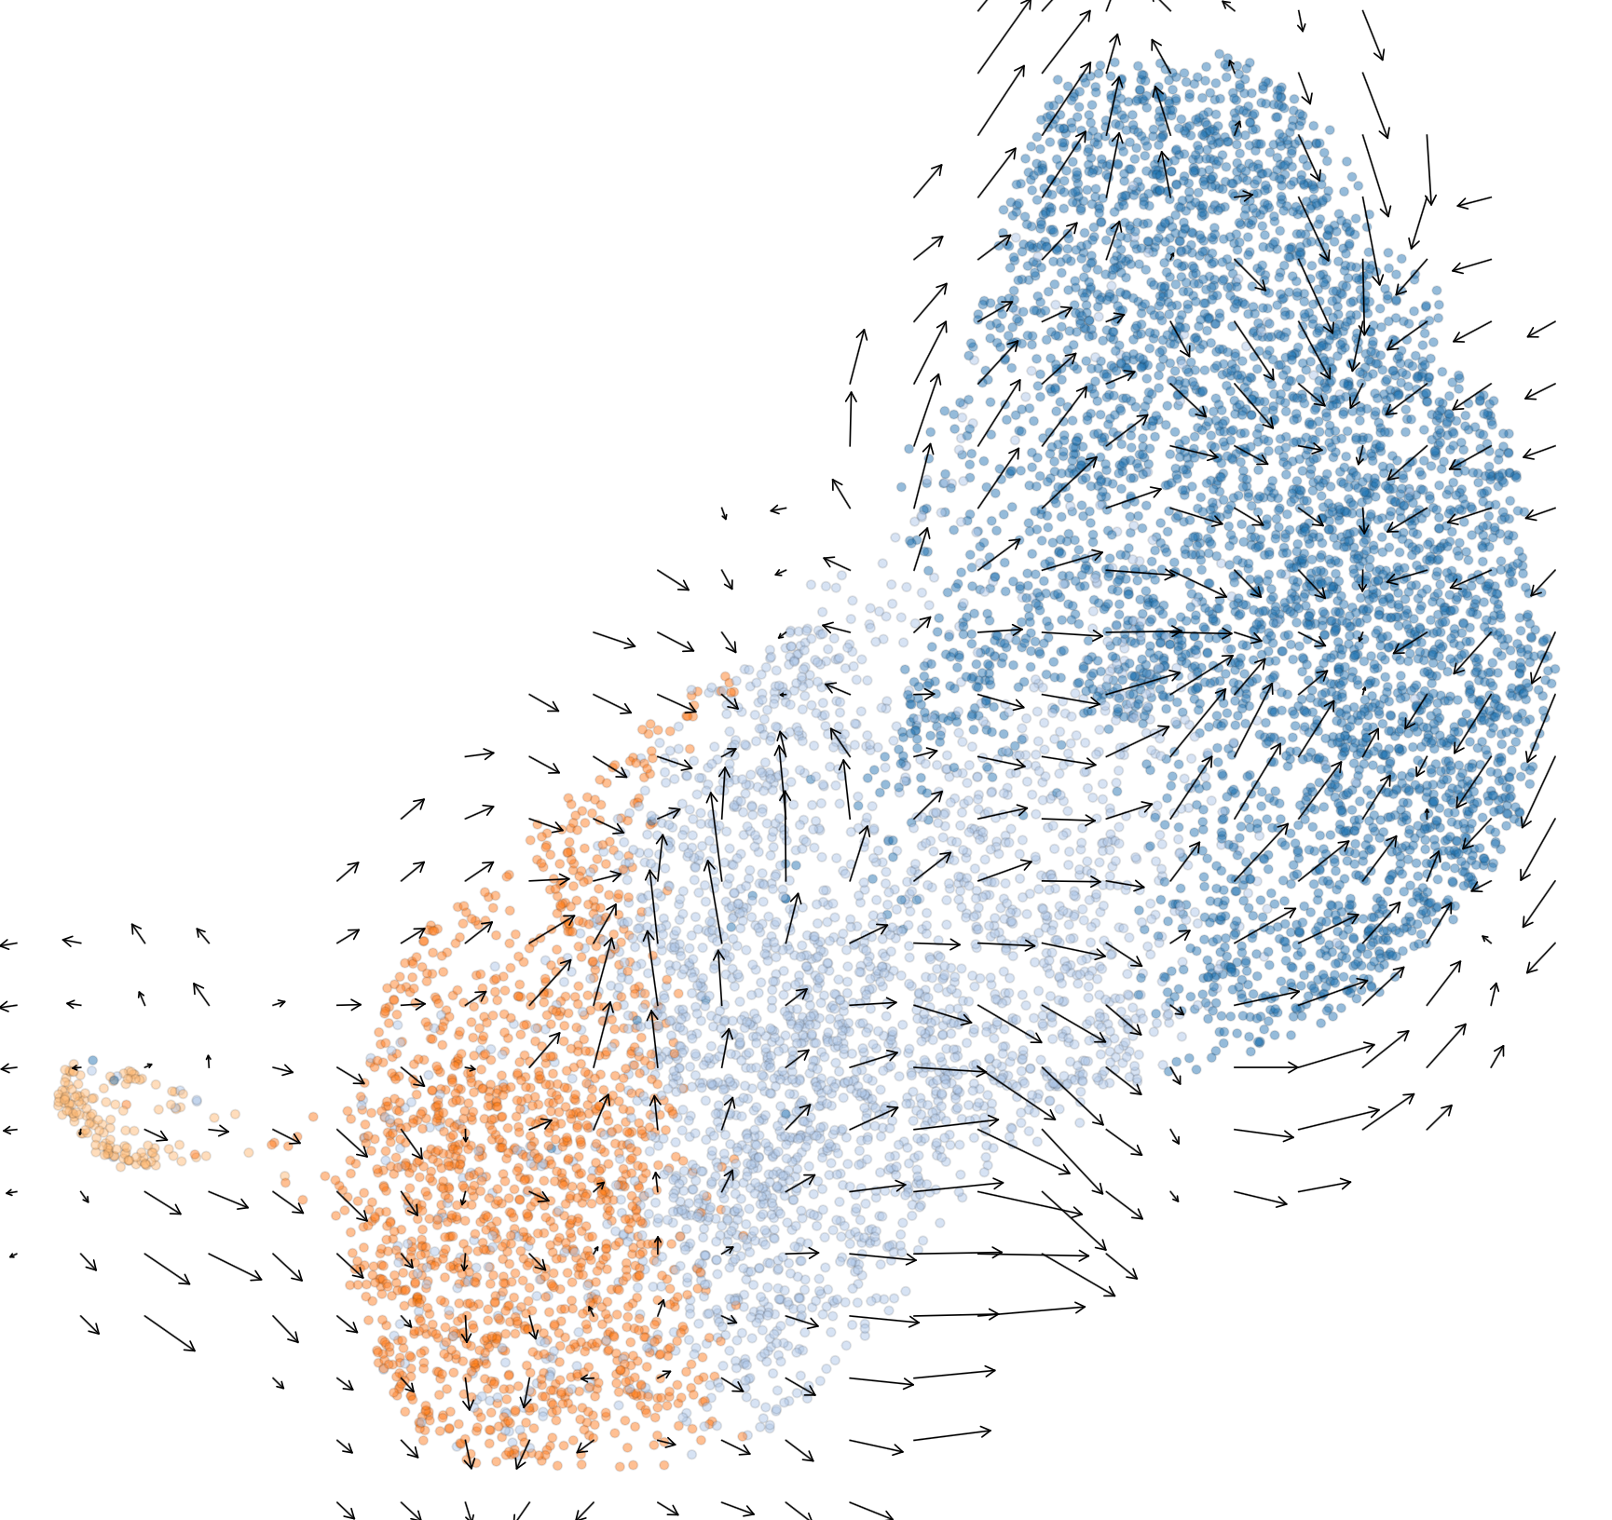
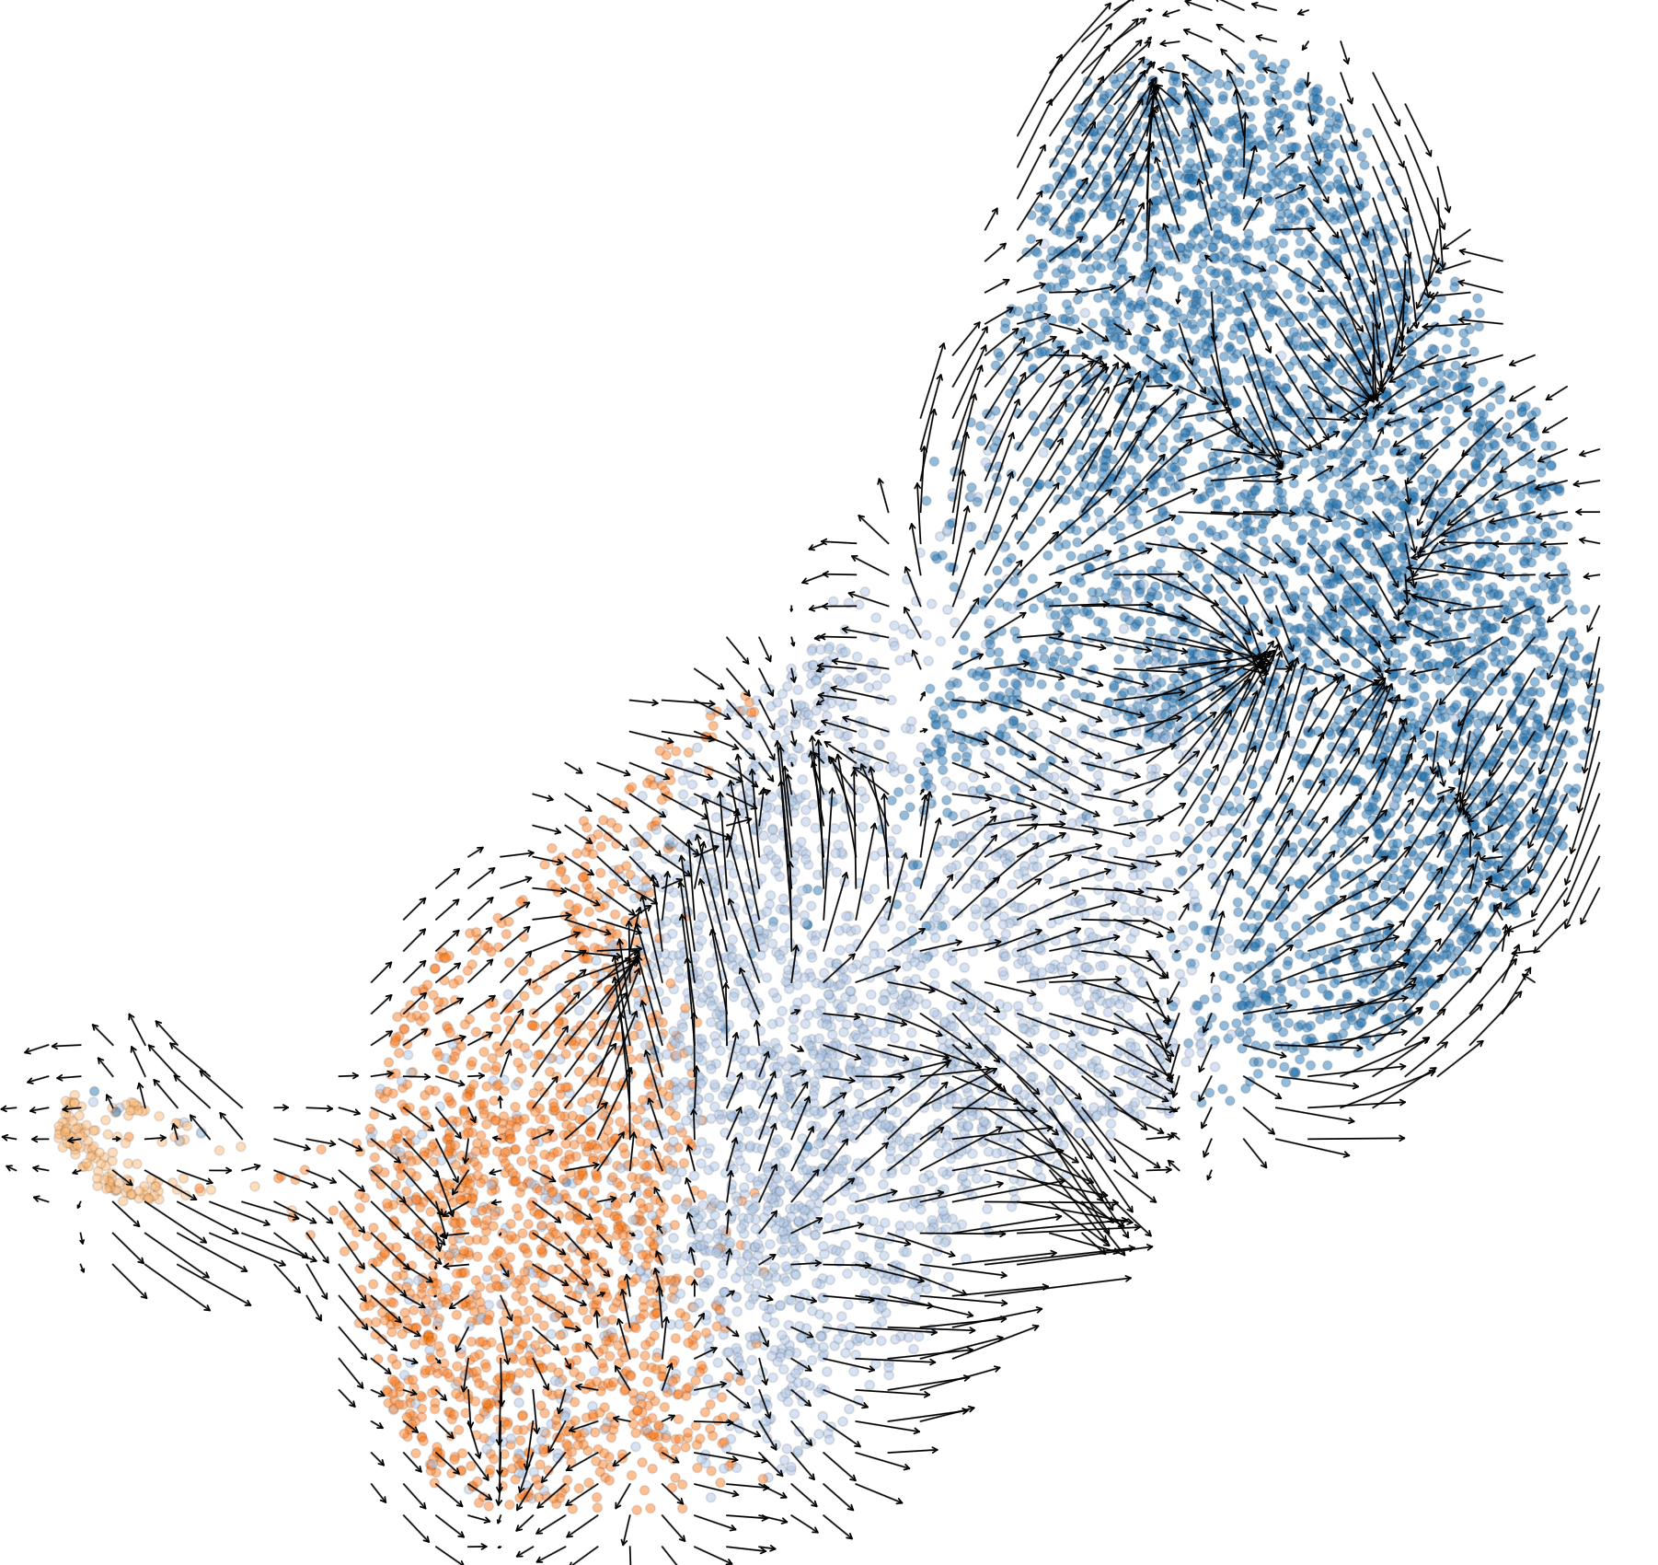
BMS-32
grid.n: number of grid points along each axis
grid.n = 25
grid.n = 50
UMAP_2
UMAP_1
Figure PDF with higher resolution rendering is available in the Dropbox Iteration 4 folder

Slide 13
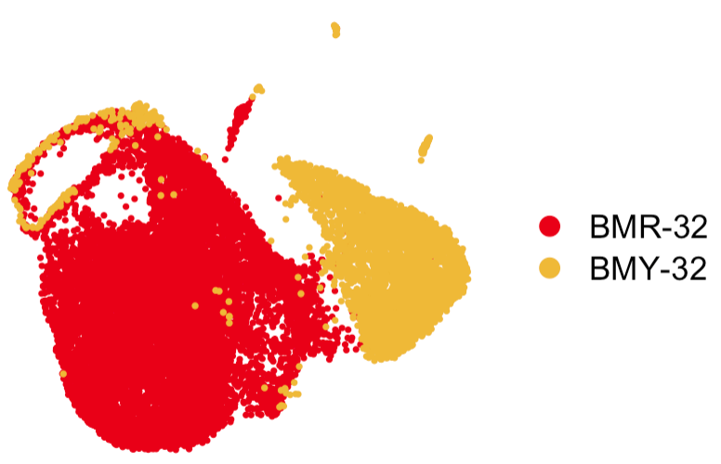
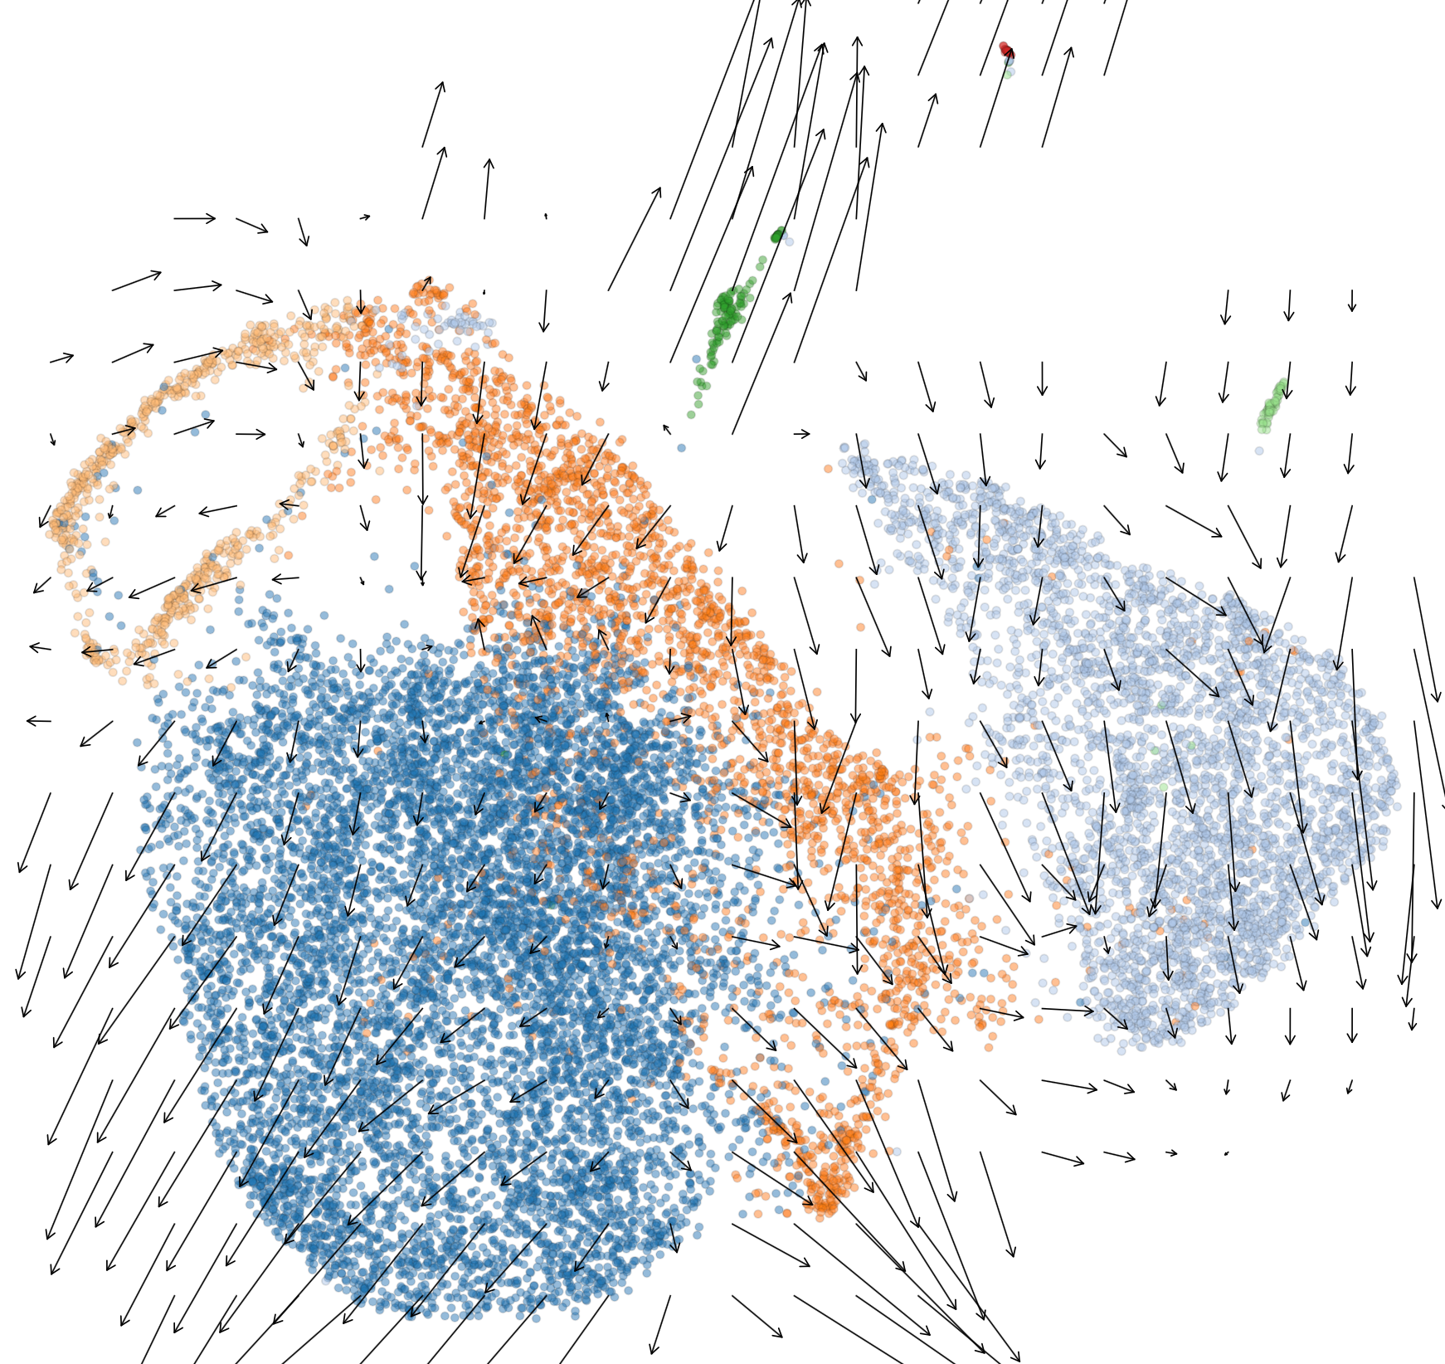
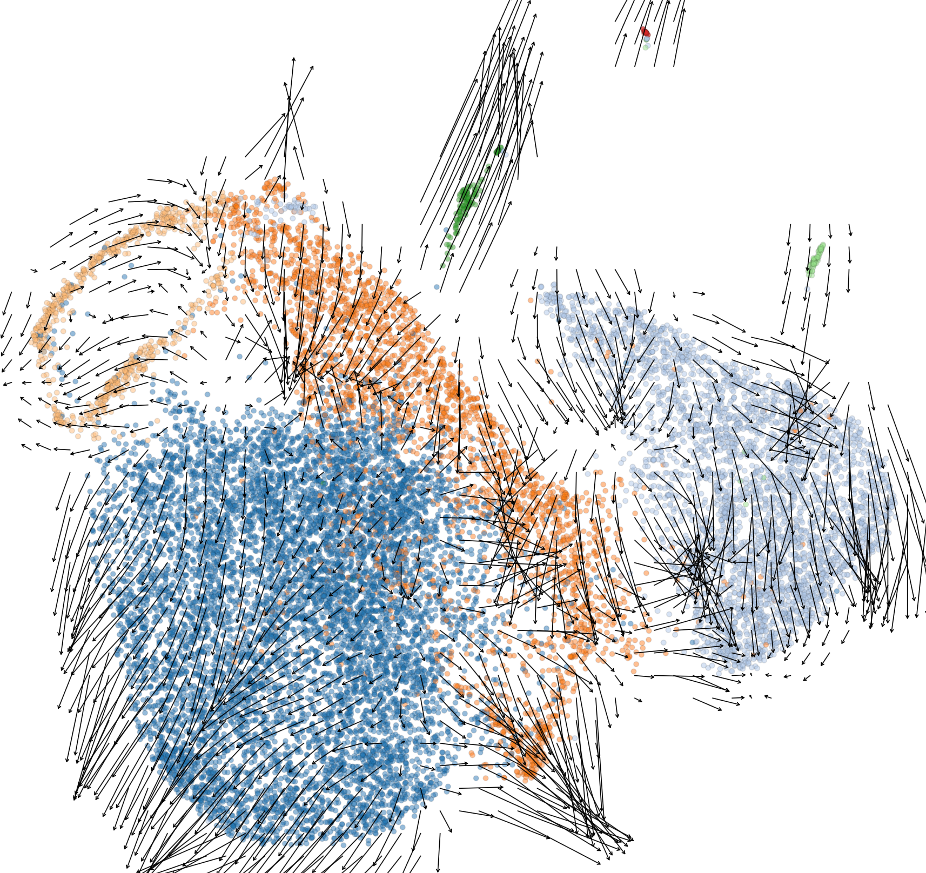
BMY+BMR
grid.n = 25
grid.n = 50
UMAP_2
UMAP_1
Figure PDF with higher resolution rendering is available in the Dropbox Iteration 4 folder

Slide 14
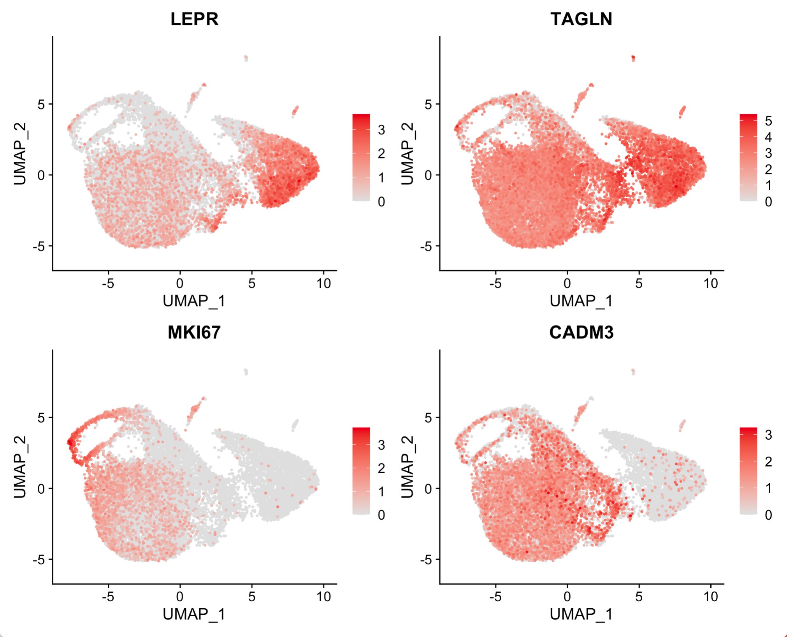
Selected genes in current UMAP projection

Slide 15
Cell cycle?
UMAP_2
UMAP_1

Slide 16
Discussion
The BMR-BMY32 Velocity analysis produces a different projection, retains similar shape as Iteration 3 analysis.
The processing of velocity analysis limited to cells & genes with detected splicing. It is possible to integrate with the previously processed results if necessary.
The trajectory prediction does not provide a clear answer to relationship between BMR and BMY.
Arrow length are scaled / can be adjusted. All plots here were rendered using identical settings.

